Slide 1
Control Structures and Loops
Overview of JavaScript's role in web development.
Mention of client-side scripting and interaction with HTML and CSS.

Slide 2
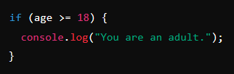
What Are Control Structures?
Control structures allow the flow of the program to change based on conditions.
Types: Conditional (if, else, else if) and Looping structures (for, while, do-while).

Slide 3
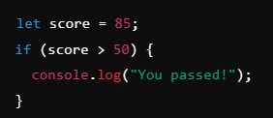
Using If Statements
Syntax of the if statement.
It checks a condition and runs a block of code if the condition is true.

Slide 4
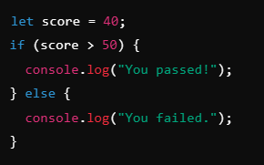
Else and Else If Statements
else: Block runs if the condition is false.
else if: Checks an additional condition if the first one fails.

Slide 5
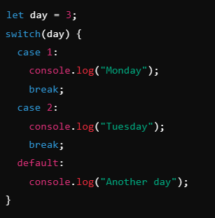
Switch Statements
Ideal for checking multiple conditions.
Compares the same variable against different values.

Slide 6
Introduction to Loops
What Are Loops:
Loops allow code to repeat multiple times.
Types: for, while, do-while.
Efficient for performing repeated tasks.

Slide 7

Using For Loops
A loop that runs a set number of times.
Syntax: Initialization, Condition, Increment/Decrement.

Slide 8
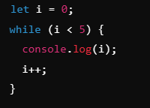
Using While Loops
Loops while a condition is true.
It checks the condition before running the code block.

Slide 9
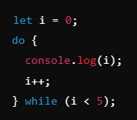
Using Do-While Loops
Similar to while, but runs the code block at least once before checking the condition.

Slide 10
Class Task: Practice Control Structures and Loops
Write a program that takes an input number and prints "Even" or "Odd" based on the number.
2. Create a for loop that prints numbers from 1 to 10.
3. Implement a switch statement that outputs the name of a day based on a given number (1-7).

